Slide 1
WELCOME
AI TRAFFIC MANAGEMENT
KATHIRAVAN.E BE.CSE
MAHENDRA INSTITUTION OF TECHNOLOGY
JOSVA.M BE.CSE
MAHENDRA INSTITUTION OF TECHNOLOGY

Slide 2
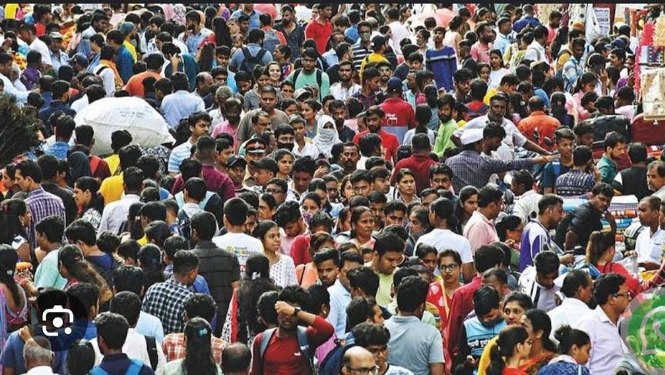
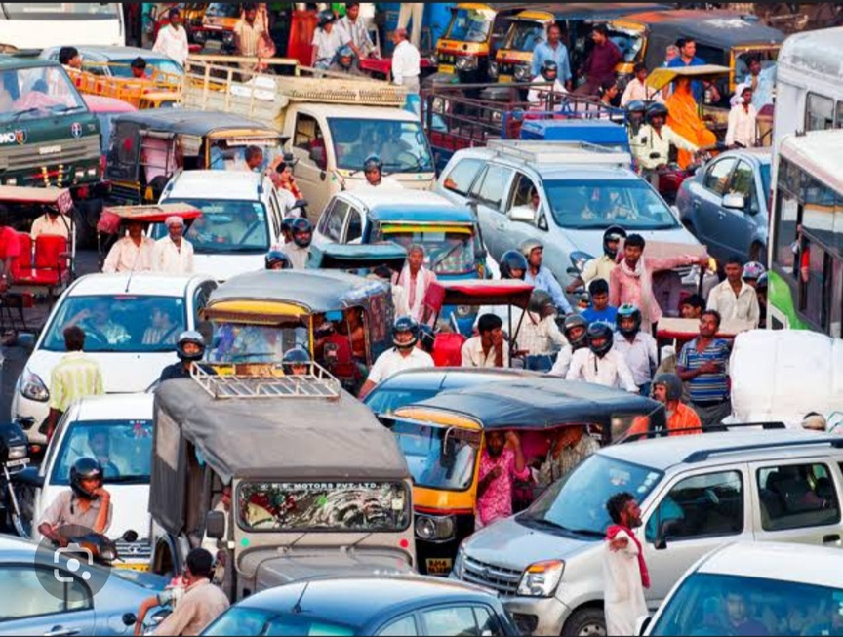
INTRODUCTION
Tamilnadu population 72,147,030
Total india population 141.72 croes (2022)
. vehicle user is 90,640,000(2022)
. In tamilnadu 338lakh vehicle was
registered at (2022
. Two wheeler users 285.24
2
Notes:
2

Slide 3
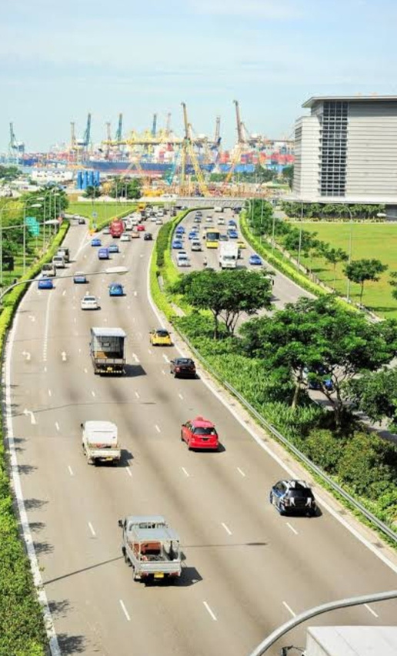
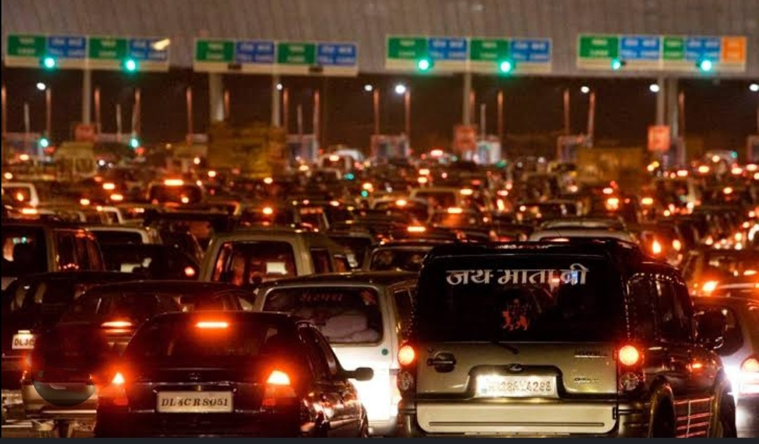
PROBLEM STATEMENT
OLDER
EARLIER
People can use vehicle travel
one place to another place
In older days we can see less amount of vehicle but now we see lacks of vehicle
In older days house can have maximum 2 or 3 vehicles
but now we can see more then 3
Lots of vehicle can run
in the road it cause traffic
3
Notes:
3

Slide 4
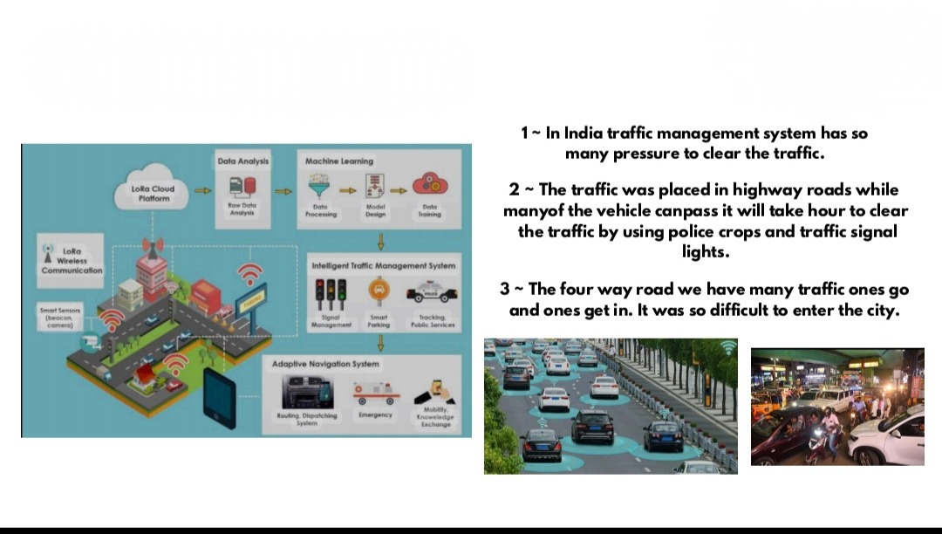
FEASIBILITY AND VIABILITY
TRAFFIC MANAGEMENT
4
Notes:
4

Slide 5
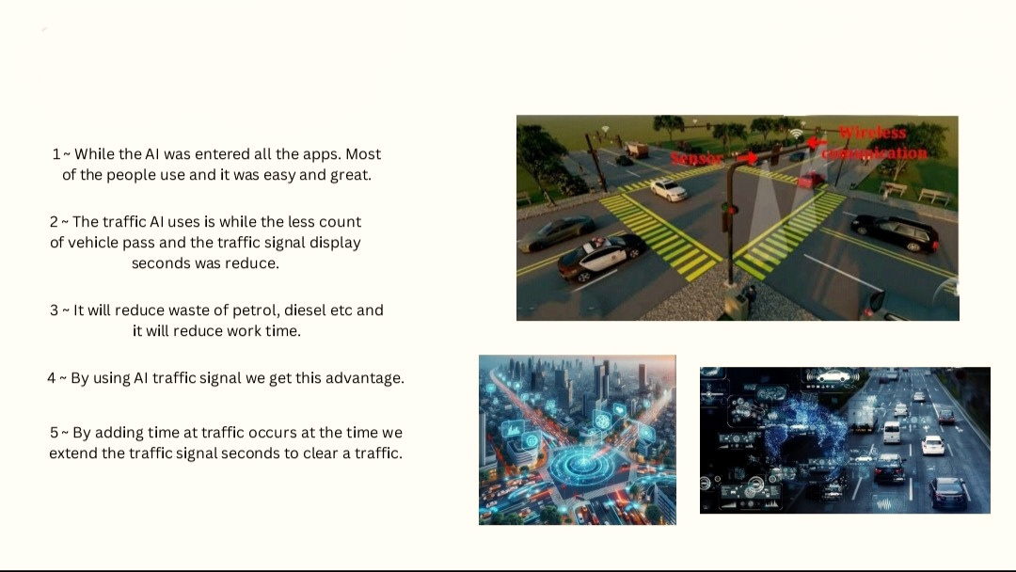
IMPACT AND BENEFITS
AI TRAFFIC MANAGEMENT
AI SIGNAL
5
Notes:
5

Slide 6
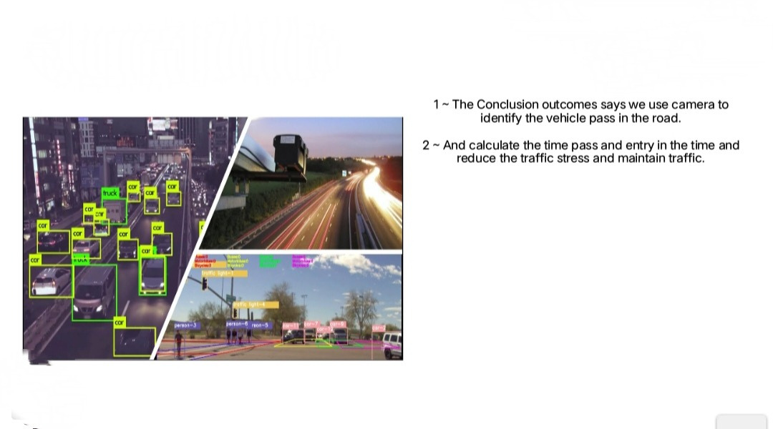
The working
6
Notes:
6

Slide 7
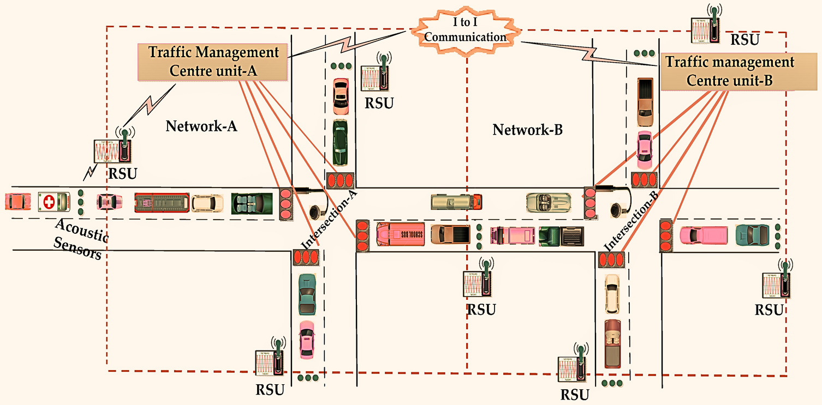
EMERGENCY VEHICLE PASSING
Emergency vehicle passing in this situation.
We using the smart ai system it will help to clear taffic and we think how the emergency vehicle on road.
We using the rsu sensor by passing the emergency vehicle.
The first signal pass the wireless communication and clear the traffic.
While the emergency vehicle passing the signal pass to the next signal and clear the traffic.
The RMS full form is(remote sensing module).

Slide 8

SOFTWARE
python is a language to create a AI
We use python because it is high level interpreter language

Slide 9
THANK YOU

